Slide 1
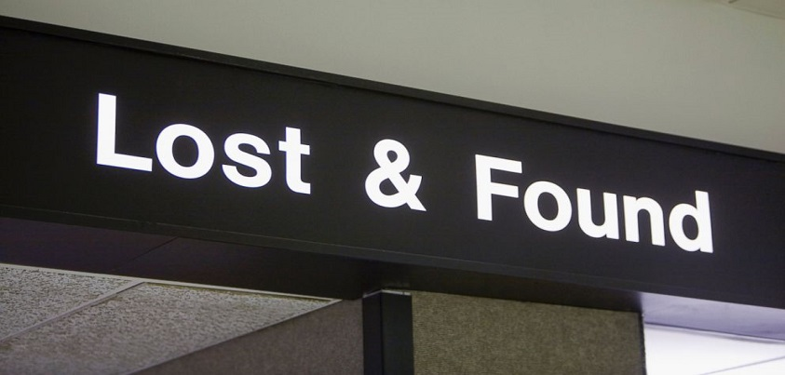

Slide 2
Problem Statement
It is a common problem encountered by the society, that, people face losses whenever they happen to misplace important document and belonging. Suffering such a situation is not basically as a result of ignorance or out of will but mostly accidental. For this reason we saw this problem addressable through a computerized system entailing a computer, a mobile handset and a web program.

Slide 4
Revenue generating model
For lost items, the claimer pays a fee to get the contact details of the person holding their misplaced item.
This fee is shared between the company and the third party who found the item.

Slide 5
Marketing
We can reach our market by advertising our services through:
Preaching
Posters
Pamphlets
Booklets
Social Media
Broadcasting corporations

Slide 6
Sustainability strategy
This system is well programmed and tested thoroughly to satisfy international standards and is developed in accordance to the international laws of software production.
We will often collect feedback from people and analyze it keenly to improve on our services

